Slide 1
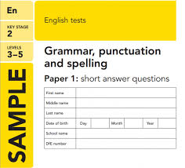
Spelling, Punctuation and Grammar Revision Guide
All you need to know to get you through the test!

Slide 2
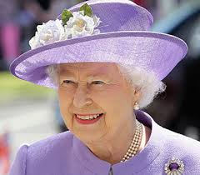
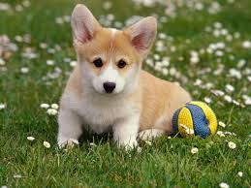
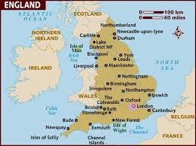
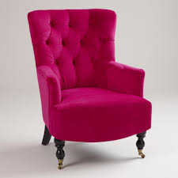
Noun
A noun is a ‘naming’ word: a word used for naming an animal, a person, a place or a thing.
Queen Elizabeth II
England
dog
chair

Slide 3
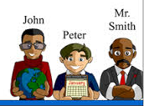
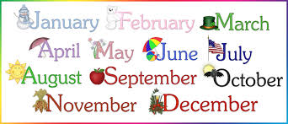
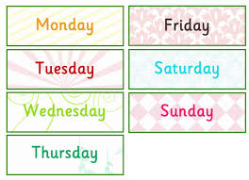
Proper nouns
Proper nouns are used to name particular people and places: Jim, Betty, London - and some ‘times’: Monday, April, Easter. Proper nouns always begin with a capital letter.

Slide 4
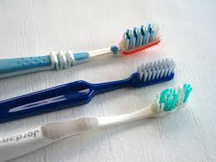
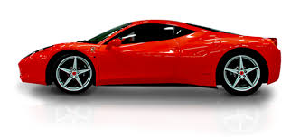
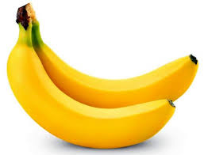
Common nouns
A common noun is a noun that is used to name everyday things: cars, toothbrushes, trees – and kinds of people: man, woman, child.

Slide 5
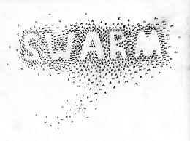
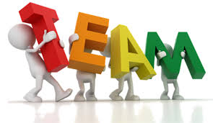
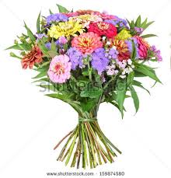
Collective nouns
Collective nouns describe a group or collection of people or things: army, bunch, team, swarm.

Slide 6
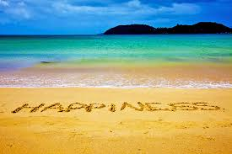
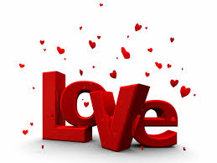
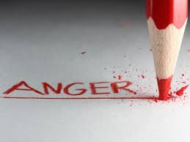
Abstract nouns
An abstract noun describes things that cannot actually be seen, heard, smelt, felt or tasted: sleep, honesty, boredom, freedom, power.

Slide 7
Adjectives
An adjective is a ‘describing’ word: it is a word used to describe (or tell you more about) a noun.
Example: The burglar was wearing a black jacket, a furry hat and a large mask over his face.
An adjective usually comes before a noun but sometimes it can be separated from its noun and come afterwards (e.g.: Ben looked frightened; the dog was very fierce)

Slide 8
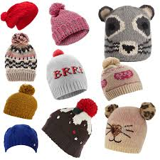
Interrogative (‘asking’) Adjectives
e.g.: What? Which? … They are used to ask questions about a noun.
Example: Which hat do you prefer?

Slide 9
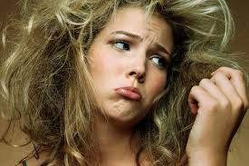
Possessive Adjectives
e.g.: my, our, their, his, your … Possessive adjectives show ownership.
Example.: Sue never brushes her hair.

Slide 10
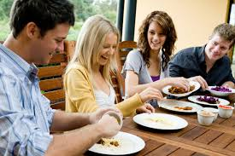
Adjectives of number or quantity
e.g. much, more, most, little, some, any, enough … These answer the question: How much?
Example: She invited five friends for dinner; she did not have any food left

Slide 11
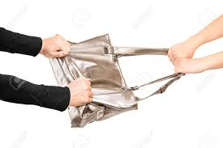
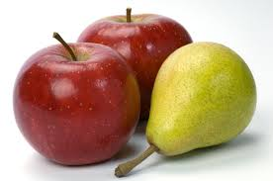
Demonstrative (‘pointing-out’) Adjectives
e.g.: this, that, these, those… Demonstrative adjectives answer the question: Which?
Example: Those apples and these pears are delicious. That man stole this handbag.

Slide 12
Verbs
A verb is a word, or a group of words, that tells you what a person or thing is being or doing. It is often called a ‘doing’ word: e.g. running, eating, sitting.
All sentences have a subject and a verb. The subject is the person or thing doing the action: Example: Cats purr (Cats is the subject and purr is the verb)

Slide 13
Auxiliary Verbs
A verb is often made up of more than one word. The actual verb-word is helped out by parts of the special verbs: the verb to be and the verb to have. These ‘helping’ verbs are called auxiliary verbs and can help us to form tenses.
Auxiliary verbs for ‘to be’ include: am, are, is, was, were,
Auxiliary verbs for ‘to have’ include: have, had, hasn’t, has, will have, will not have.
Examples:
I have arrived (‘arrived’ is the main verb and ‘have’ is the auxiliary verb)
We are waiting (‘waiting’ is the main verb and ‘are’ is the auxiliary verb)

Slide 14
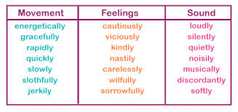
Adverbs
An adverb tells you more about the verb (it ‘adds’ to the verb). It nearly always answers the questions: How? When? Where? or Why?
Most adverbs in English end in –ly and come from adjectives:
E.g. soft – softly; slow – slowly.

Slide 15
Adverb or Adjective?
Some words can be either adverbs or adjectives depending on what they do in a sentence, e.g. fast, hard, late.
If they answer the questions: How? When? Where? or Why? – they are adverbs.
If they answer the question: “What is it like?” - they are adjectives, and will be telling you more about a specific noun.
Examples:
Life is hard. (adjective)
Kim works hard. (adverb)
The train arrived early. (adverb)
I took an early train. (adjective)

Slide 16
Pronouns
Sometimes you refer to a person or a thing not by its actual name, but by another word which stands for it. The word you use to stand for a noun is called a pronoun (which means ‘for a noun’)
We use pronouns so that we do not have to repeat the same nouns over again.
Have a look at the following sentence: When Barnaby stroked the cat and listened to the cat purring softly, Barnaby felt calm and peaceful.
Compare it with the same sentence where some of the nouns have been replaced by pronouns: When Barnaby stroked the cat and listened to it purring softly, he felt calm and peaceful.

Slide 17
Singular Pronouns
Singular pronouns are used to refer to one person or thing.
E.g.: I, you, me, he, she, it, you, him, her, mine, yours, his, hers, its

Slide 18
Plural Pronouns
Plural pronouns are used to refer to more than one person or thing.
E.g.: we, they, us, them, ours, yours, theirs

Slide 19
Prepositions
Prepositions are words which show the relationship of one thing to another.
Examples: Tom jumped over the cat.
The monkey is in the tree.
These words tell you where one thing is in relation to something else.
Other examples of prepositions include: up, across, into, past, under, below, above …

Slide 20
Connectives (conjunctions)
Connectives (conjunctions) join together words, phrases, clauses and sentences. They help us to create compound sentences by joining two main clauses together.
E.g.: She went to the shops. She bought a box of chocolates.
We can use a conjunction to join these sentences together:
She went to the shops and bought a box of chocolates.
Other connectives (conjunctions) include: but, as, so, or …

Slide 21
Subordinating connectives
Subordinating connectives link a main (independent) clause with a subordinate (dependent) clause (a clause which does not make sense on its own).
Example: When we got home, we were hungry.
We were hungry because we hadn’t eaten all day.
Other subordinating connectives include: if, while, after, until, before , although…

Slide 22
Articles
An article is always used with and gives some information about a noun. There are three articles: a, an and the
Examples: the chair; a table; an elephant
*There is sometimes confusion about whether to use a or an. The sound of a word’s first letter helps us to know which to use: If a word begins with a vowel sound, you should use an; if a word begins with a consonant sound, you should use a.

Slide 23
Statements
These are sentences which state facts.
e.g.: It is hot.
The butter is in the fridge.

Slide 24
Questions
Questions are sentences which ask for an answer.
e.g.: Are you hot?
Where is the butter?

Slide 25
Commands
These are sentences which give orders or requests.
e.g.: Play the movie.
Give me a dinosaur for my birthday.

Slide 26
Exclamations
Exclamatory sentences (exclamations) are sentences which express a strong feeling of emotion.
e.g.: My goodness, it’s hot!
I absolutely love this movie!

Slide 27
Clauses
A clause is a group of words which does contain a verb; it is part of a sentence.
There are two kinds of clauses:
A main clause (makes sense on its own) e.g.: Sue bought a new dress.
A subordinate clause (does not make sense on its own; it depends on the main clause for its meaning)
Example Sue bought a new dress when she went shopping.
‘when she went shopping’ is the subordinate clause because it would not make sense without the main clause.

Slide 28
Phrases
A phrase is a group of words which does not make complete sense on its own and does not contain a verb. It is not a complete sentence.
Example ‘up the mountain’

Slide 29
Synonyms
These are words that have a similar meaning to another word. We use synonyms to make our writing more interesting.
Bad - awful, terrible, horrible
Happy - content, joyful, pleased
Look - watch, stare, glaze
Walk - stroll, crawl, tread

Slide 30
Antonyms
These are words with the opposite meaning to another word.
The antonym of up is down
The antonym of tall is short
The antonym of add is subtract

Slide 31
Word groups/ families
These are groups of words that have a common feature or pattern - they have some of the same combinations of letters in them and a similar sound.
at, cat, hat, and fat are a family of words with the "at" sound and letter combination in common.
bike, hike, like, spike and strike are a family of words with the "ike" sound and letter combination in common.
blame, came, fame, flame and game are a family of words with the "ame" sound and letter combination in common.

Slide 32
Prefixes
Prefixes are added to the beginning of an existing word in order to create a new word with a different meaning.
Adding ‘un’ to happy to make unhappy
Adding ‘dis’ to appear to make disappear
Adding ‘re’ to try to make retry

Slide 33
Suffixes
Suffixes are added to the end of an existing word to create a new word with a different meaning.
Adding ‘ish’ to child to make childish
Adding ‘able’ to like to make likeable
Adding ‘ion’ to act to make action

Slide 34
Root words
Root words are words that have a meaning of their own but can be added to either with a prefix (before the root) or a suffix (after the root) to change the meaning of the word. Root words can often be helpful in finding out what a word means or where it is ‘derived’ from.
help is a root word
It can grow into:
helps
helpful
helped
helping
helpless
unhelpful

Slide 35
Singular
A singular noun names one person, place or thing (a single item).
One bike
One mango
One dress
One fly
One turkey
One half

Slide 36
Plural
More than one person, place or thing.
Most nouns are made into plurals by adding –s:
Three bikes
Some nouns ending in –o are made into plurals by adding –es:
Two mangoes
Most nouns ending in hissing, shushing or buzzing sounds are made into plurals by adding –es:
Ten dresses
For words ending in a vowel and then –y, just add –s:
Eight turkeys
For words ending in a consonant and then –y, change -y to -i
and add –es:
Five flies
Most nouns ending in -f or-fe change to -ves in the plural:
Six halves

Slide 37
Capital letter
Used to denote the beginning of a sentence or a proper noun (names of particular places, things and people).
Joel has multi sports every Monday afternoon at Roscoe Primary School.
In January, the children will be visiting Chester Zoo.

Slide 38
Full stop
Placed at the end of a sentence that is not a question or exclamation.
Terry Pratchett's latest book is not yet out in paperback.
I asked her whether she could tell me the way to Brighton.

Slide 39
Question marks
Indicates a question/disbelief.
Who else will be there?
Is this really little Thomas?

Slide 40
Exclamation marks
Indicates an interjection/surprise/strong emotion.
What a triumph!
I’ve just about had enough!
Wonderful!

Slide 41
Inverted commas
Punctuation marks used in pairs ( “ ”) to indicate:
• quotes (evidence).
• direct speech
• words that are defined, that follow certain phrases or that have special meaning.
For direct speech:
Janet asked, "Why can't we go today?"
For quotes:
The man claimed that he was “shocked to hear the news”.
For words that are defined, that follow certain phrases or that have special meaning:
'Buch' is German for book.
The book was signed 'Terry Pratchett'.
The 'free gift' actually cost us forty pounds.

Slide 42
Apostrophes
Used to show that letters have been left out (contractions) or to show possession (i.e. ‘belonging to’)
Contractions:
Is not = isn’t Could not = couldn’t
Showing Possession:
With nouns (plural and singular) not ending in an s add 's:
the girl’s jacket, the children's books
With plural nouns ending in an s, add only the apostrophe:
the guards' duties, the Jones' house
With singular nouns ending in an s, you can add either 's or an apostrophe alone:
the witness's lie or the witness' lie (be consistent)

Slide 43
Commas in a list
Used between a list of three or more words to replace the word and for all but the last instance.
Jenny’s favourite subjects are maths, literacy and art.
Joe, Evan and Mike were chosen to sing at the service.
The giant had a large head, hairy ears and two big, beady eyes.

Slide 44
Commas to mark phrases or clauses
To indicate contrast:
The snake was brown, not green, and it was quite small.
Where the phrase (embedded clause) could be in brackets:
The recipe, which we hadn't tried before, is very easy to follow.
Where the phrase adds relevant information:
Mr Hardy, aged 68, ran his first marathon five years ago.
To mark a subordinate clause:
If at first you don't succeed, try again.
Though the snake was small, I still feared for my life.
Introductory or opening phrases:
In general, sixty-eight is quite old to run a marathon.
On the whole, snakes only attack when riled.
Conjunctive verbs:
Unfortunately, the bear was already in a bad mood and, furthermore, pink wasn't its colour.

Slide 45
Brackets (parentheses)
Used for additional information or explanation.
To clarify information:
Jamie's bike was red (bright red) with a yellow stripe.
For asides and comments:
The bear was pink (I kid you not).
To give extra details:
His first book (The Colour Of Magic) was written in 1989.

Slide 46
Ellipses
Used to indicate a pause in speech or at the very end of a sentence so that words trail off into silence (this helps to create suspense).
A pause in speech:
“The sight was awesome… truly amazing.”
At end of a sentence to create suspense:
Mr Daily gritted his teeth, gripped the scalpel tightly in his right hand and slowly advanced…

Slide 47
Dashes
Used to show interruption (often in dialogue) or to show repetition.
To show interruption:
“The girl is my – “
“Sister,” interrupted Miles, “She looks just like you.”
To show repetition:
“You-you monster!” cried the frightened woman.
“St-st-stop!” stammered the boy.

Slide 48
Colons
a) Used before a list, summary or quote
Used to complete a statement of fact
Before a list:
I could only find three of the ingredients: sugar, flour and coconut.
Before a summary:
To summarise: we found the camp, set up our tent and then the bears attacked.
Before a line of speech:
Tom asked: “May I have another cupcake?”
Before a statement of fact:
There are only three kinds of people: the good, the bad and the ugly.

Slide 49
Semi-colons
Used in place of a connective (conjunction). Shows thoughts on either side of it are balanced and connected. It can also separate words or items within a list.
To link two separate sentences that are closely related:
The children came home today; they had been away for a week.
In a list:
Star Trek, created by Gene Roddenberry; Babylon 5, by JMS; Buffy, by Joss Whedon; and Farscape, from the Henson Company.

